Slide 1
Learning from failures
Research engagement: a failure story
Vincenzo Capone
Linz (AT)
31 May 2017

Slide 2
Context
Bio-imaging community (Life Science)
2 institutions having issues with data transfer to a major research centre
  Very poor throughput (<100Mbit)
First contact in a Community Workshop
“We need a network upgrade"

Slide 3
The M.O.
Gather information from the sites
Identify the involved parties
Estimate the extent of the problem

Slide 4
First step

Slide 5
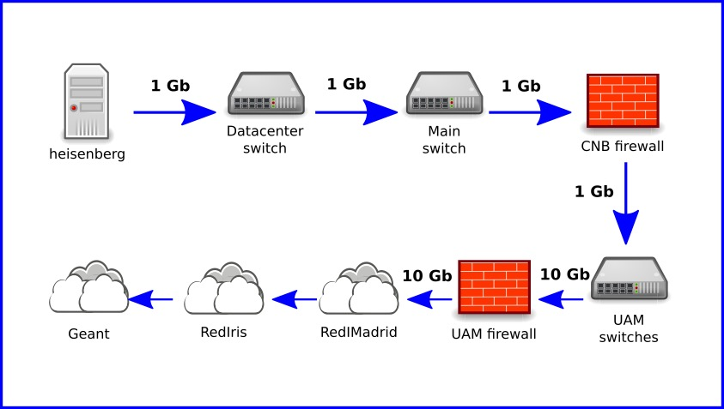

Tough luck… let’s try again
©1999 20TH CENTURY FOX FILM CORP.

Slide 6
”Engage your IT department”
We don’t know what to ask
They don’t understand what we need
They don’t talk to us!

Slide 7

“Engage your NREN”
What do you mean by NREN?....

Slide 8
Epilogue
We were not able to help
Users keep shipping disks

Slide 9
Lessons learned

Slide 10


Slide 11

Not all users are aware of what we do/are

Slide 12
Scientists are NOT (usually) IT people
IT departments need to be part of the conversation
Sometimes (all the time, really…) there’s money involved

Slide 13

Collaborate!
Possibly start a task force…

Slide 14
vincenzo.capone@geant.org

